Slide 1


Let’s continue!
Milestone 0
JS recap
Monday, September 21, 2026
JS recap day 2 of 2
Notes:
R

Slide 2
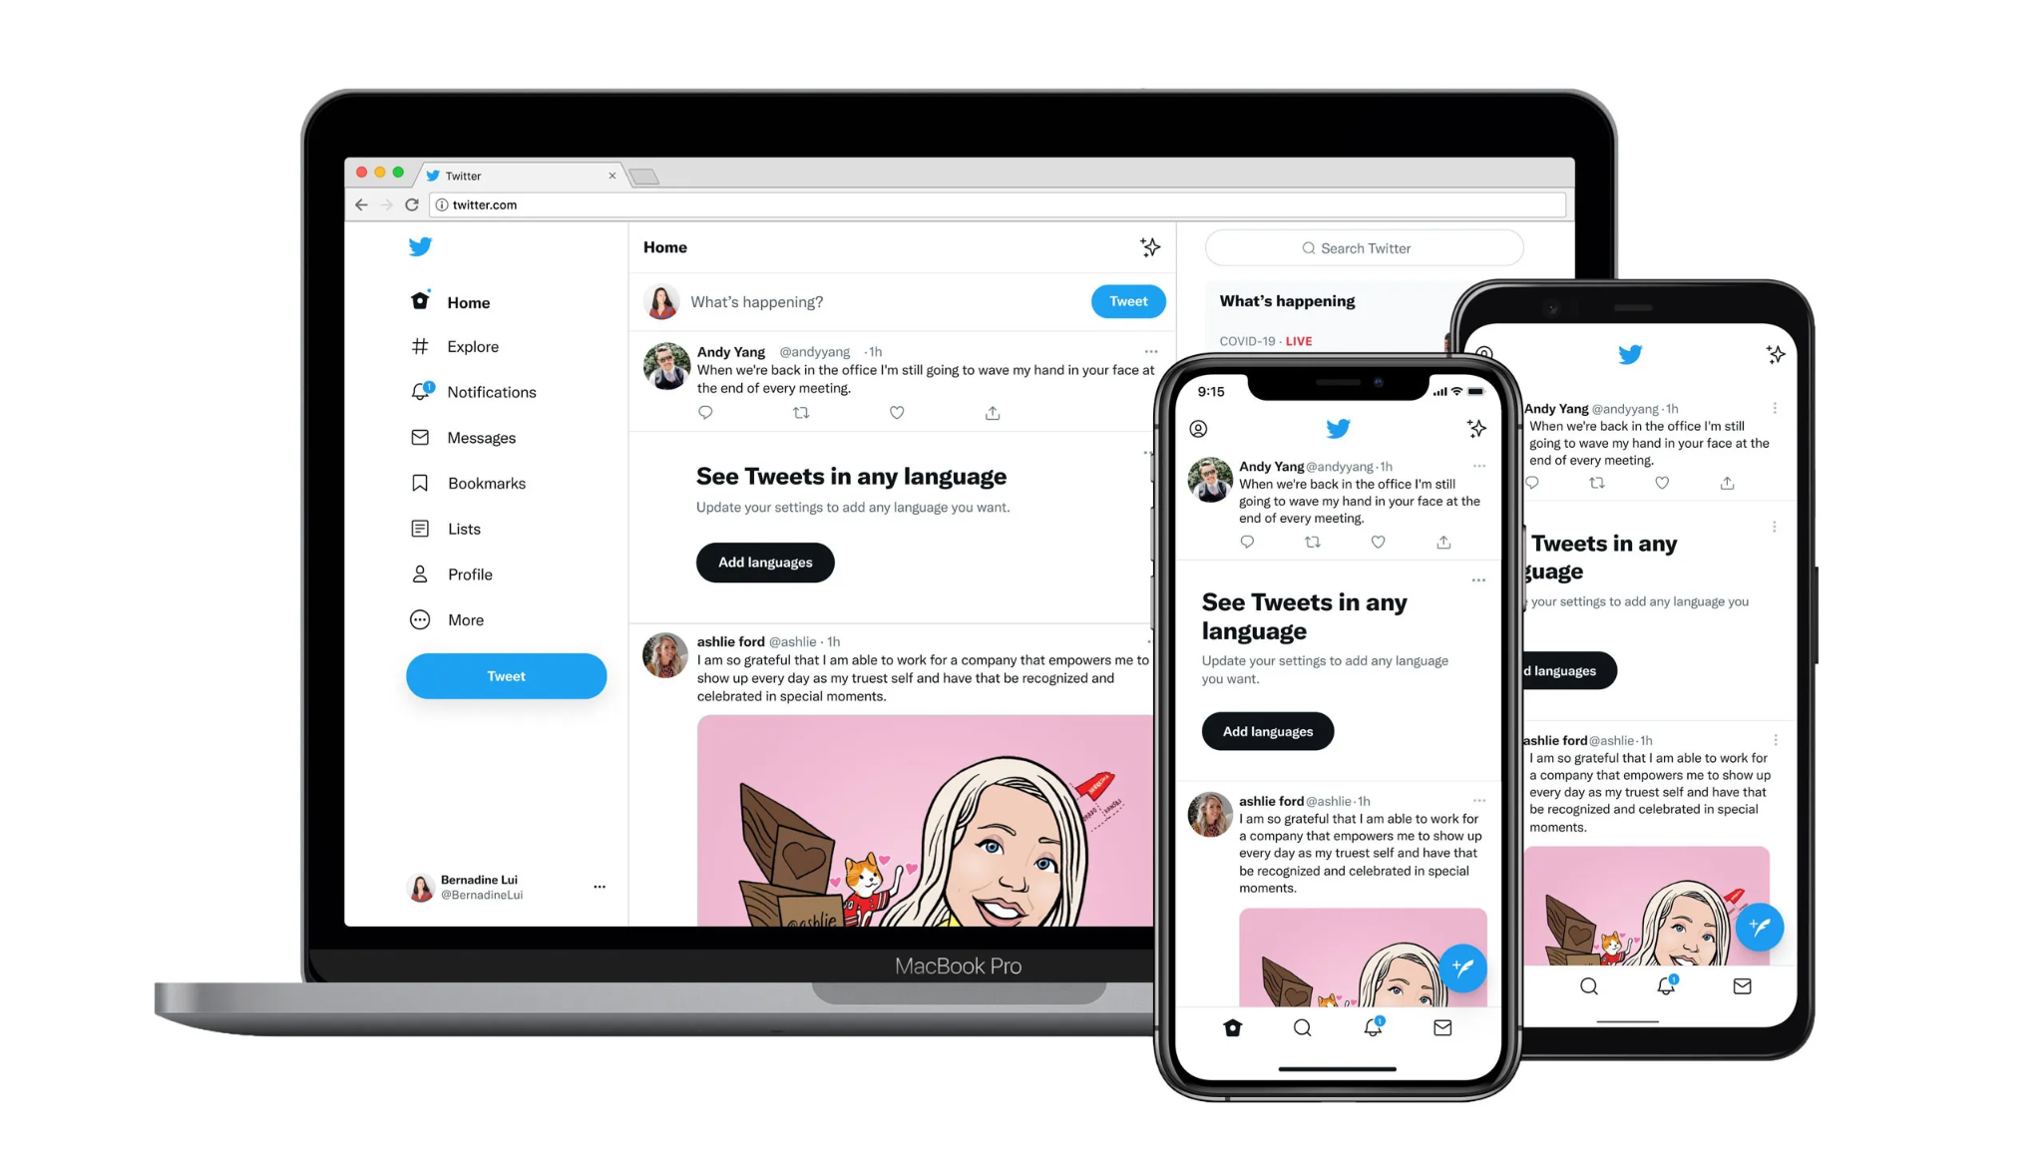
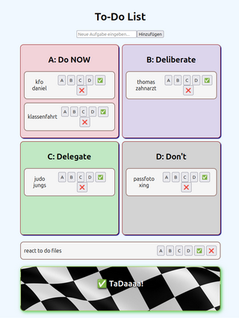
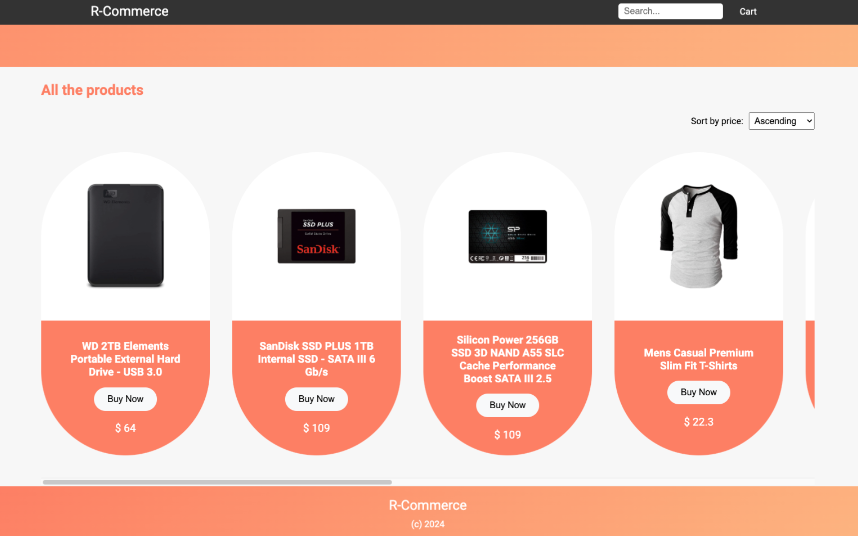
Course Topics - 2 projects
HTML/CSS with JS
xxxxx React xxxxxx
Full-stack web-app
Websites and web apps with responsive design, animations, interactions on the site, fetching data by APIs, persistence with localStorage…
Build an e-commerce with product listing, shopping cart, and dynamic filtering.
Create a clone of Twitter with tweet functionalities, user interactions and real-time updates
‹#›

Slide 3
01
04
02
05
03
06
Outline
Warm-Up
Break
Check in & “mood-o-meter” 😳😎🤯
10 min
10 min
⏮️ Last time - JS basics
JS for React
10 min
45 min
objects, arrays, destructuring
DOM manipulation, localStorage => SPA (To Do List)
recap of JS basics - contd.
Frontend Web App
30 min
Next class
functions, promises, asynchronicity
Build a Grocery List
Notes:
Old:
14:00 - 15:00 Arrow
15:00 - 15:10 Break
15:10 - 16:00 forEach & co.
16:10 - 16:10 Break
16:10 - 17:00 Modules
New:
14:00 - 15:00 Arrow functions & destructuring => lecture
15:00 - 15:10 Break
15:15 - 15:50 Arrow functions & destructuring => exercises (40m)
15:50 - 15:55 Break (5m)
15:55 - 16:15 forEach & co. => theory (20m)
16:15 - 16:55 forEach & co. => exercises (40m)
16:55 - 17:00 Modules (5m)

Slide 4
01
Warm-Up
Check in & “mood-o-meter” 😳😎🤯

Slide 5
02
⏮️ Last time - JS basics
objects, arrays, destructuring

Slide 6
03
Recap of JS basics - contd.
functions, promises, asynchronicity

Slide 7
03
Promises
JS basics
Functions
Asynchronicity
Promises -> MDN documentation

Slide 8
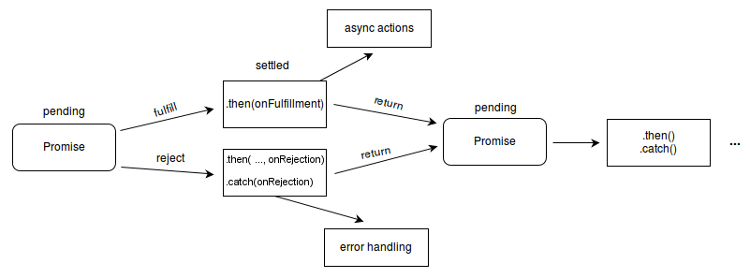
03
Promises
JS basics
Functions
Asynchronicity
Promises -> MDN documentation
Source: MDN documentation

Slide 9
04
Break!
🌬️
⏳️
☕️
See you again in 10 Minutes 😉
🚾
🏴‍☠️
surprise inside
Notes:
Go over Anil’s quiz

Slide 10



05
JS for React and Next.js
DOM manipulation, localStorage => SPA (To Do List)

Slide 11
Final questions?
🏴‍☠️
surprise inside
📸
❕let’s make a group picture 😁
Notes:
Go over Anil’s quiz

